Slide 1
Enhanced Retrieval and Generation System for Reference Documents
Revolutionizing access to critical reference information for knowledge-workers Group 3 - Jeet Das - ad5f2@mail.umkc.edu

Slide 2
Introduction
Difficulty in locating critical information in extensive reference manuals
Reference manuals range from a few hundred to thousands of pages
Hundreds of hours spent sourcing information which could be utilized in solving problems
Millions of dollars are spent every year in systems, human hours, validation of methods, etc.

Slide 3
Objectives
Natural language querying
Information retrieval and generation
Customizable responses
Easy integration with an API

Slide 4
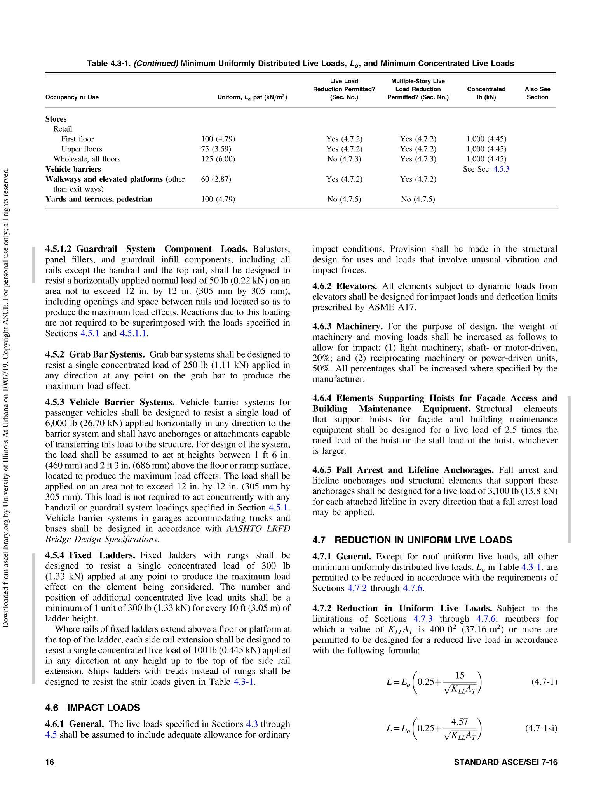
Scope
Tables, images, etc won’t be supported
Focus:
Civil engineering
reference manuals
Limitations:
Multi-modal nature of data
All text based content will be supported
Equations will be supported
Sample page from ASCE 7-16 manual

Slide 5

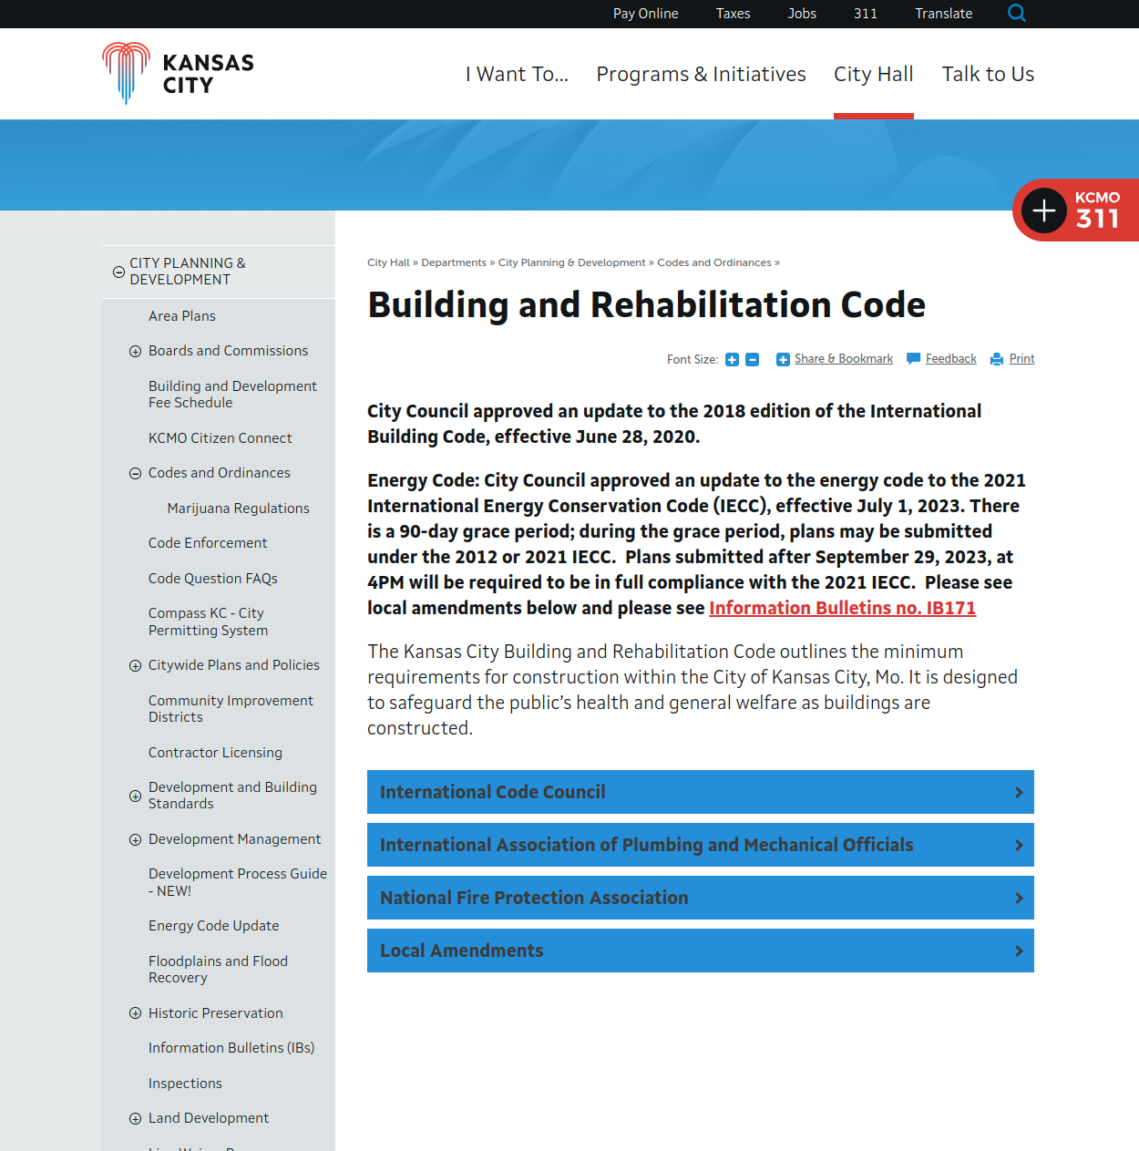
Data sources
Primary: Civil Engineering Reference Manuals
Eg: ASCE (American Society for Civil Engineers) Reference manuals
Secondary: Technical Documents and Resources
Eg: Reference documents available on the web

Slide 6
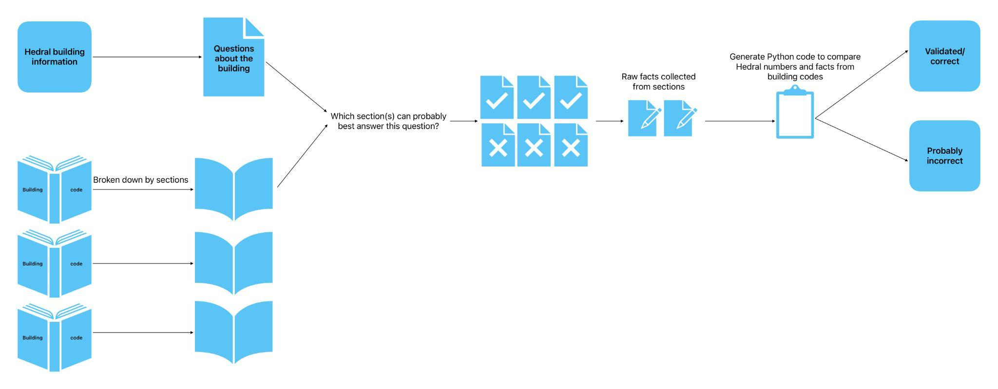
Methodologies

Slide 7
Timeline
September 2023: Research and Proof of Concepts
October 2023: System Development Begins
November 2023: Extensive Testing and API Development
December 2023: Baseline Development and Enhancements

Slide 8
Evaluation and outcomes
Evaluation (Testing driven)
Depth and clarity of answers
Accuracy in information retrieval
Seamless integration via API
Outcomes
Enhanced productivity for Civil Engineers
Efficient decision-making support
User-Friendly integration

Slide 9
Innovation
Innovation: Technological edge with decoder-transformer based models
Cutting-Edge LLMs: GPT Family of transformers
Efficient Data Storage: Vector databases
User-Friendly Access: REST API

Slide 10
Real-world applications
Same problem, different domain:
Applications beyond Civil Engineering
Similar problem, different domain:
Adaptable to various domains
Different problem, different domain:
Similar information retrieval challenges

Slide 11
Conclusion
Project Recap: Objectives and Scope
Future Impact: Enhancing Productivity and Decision-Making

Slide 12
Thank you!
Open to questions (and help)!

